Slide 1
Nervous System Outline.
I. CNS
II. Peripheral Nervous System.
Afferent - Sensory, signals go to the brain.
Efferent - Motor and physiological control. Signals come from the brain.
Main effect of local anesthetics is on the afferent nervous system. Also included is spinal nerve blockage which is a “local” CNS effect.
Summary of local anesthetic action.
loss of sensation and pain. May include loss of motor function
drugs are usually injected directly at the site of anesthesia, or may be topically administered.
choice of drug is often based on the duration required
major side effect is convulsions and/or CNS depression from excess systemic absorption.
Drugs are often administered with epinephrine to slow systemic absorption (vasoconstrictive effect). This decreases the side effects and increases the duration. Some cause vasoconstriction directly, like cocaine

Slide 2
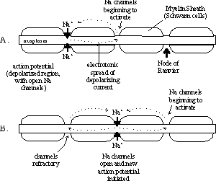
Mechanism of action.
Generally, local anesthetics interfere with Na⁺ ion channel passage across the nerve cell membrane. The greatest effect is on small, unmyelinated nerves. Myelinated nerves are also susceptible due to access at the nodes of Ranvier.
Figure 4. Regeneration of action potentials at the nodes of Ranvier. (A) the influx of Na+ ions with an action potential at one node results in the depolarization of that region of the axonal membrane. The depolarizing current moves the next Node of Ranvier because the high resistance of the myelin sheath prevents discharge of the internodal membrane capacitance. (B) The nodal region, however, depolarizes to threshold, resulting in a new action potential. By this mechanism, the action potential "jumps" down the axon. http://human.physiol.arizona.edu/sched/cv/wright/16action.htm

Slide 3
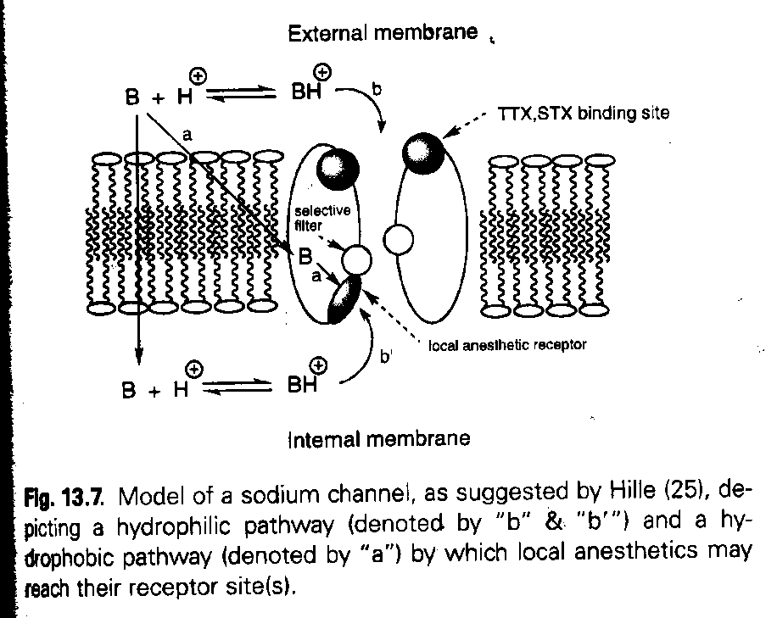
Mechanism II
The unionized form of local anesthetics diffuses through the nerve cell membrane to a specific hydrophobic binding site on the Na⁺ ion channel. The ability to exist in an ionized form improves water solubility and there may be polar interactions between the drug and the binding site. All the injectable anesthetics exist as a equilibrium mixture of ionized and unionized forms.

Slide 4
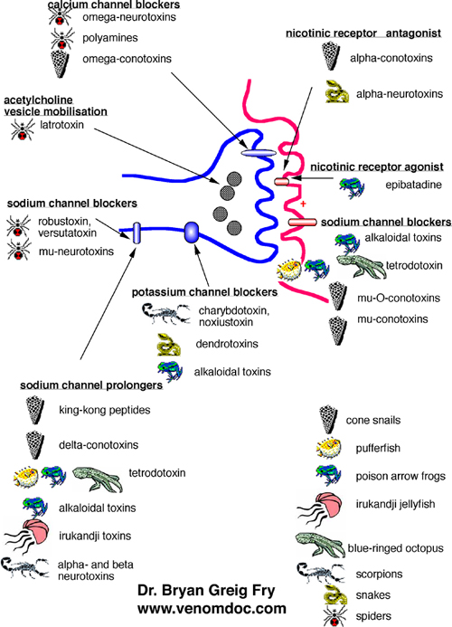
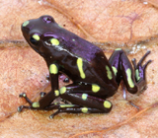
Ion Channel Blockers

Slide 5
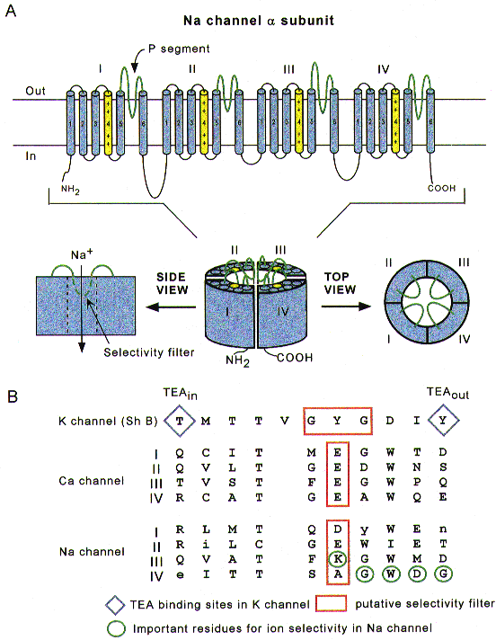
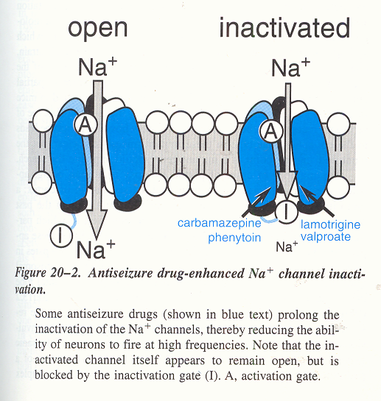
Ion Channels
Figure 1. Schematic depictions of the Na⁺ channel subunitA, putative transmembrane folding. The charged S4 segments are shown in yellow, and the pore-lining P segments in green. B, aligned primary amino acid sequences in single-letter code of the P segments in a K⁺ channel (Shaker B), the four domains of the cardiac L-type Ca²⁺ channel, and the four domains of the Na⁺ channel. Residues shown in upper case are highly conserved among voltage-dependent Na⁺ channels. The diamonds indicate the external and internal binding sites for tetraethylammonium (TEA) ion in the K⁺ channel and the red boxes outline the putative selectivity filters, although, in the case of the Na⁺ channel, the residues which are most important for selectivity (circled in green) are mostly outside the box. http://jp.physoc.org/content/vol508/issue3/fulltext/647/647-F1.html

Slide 6
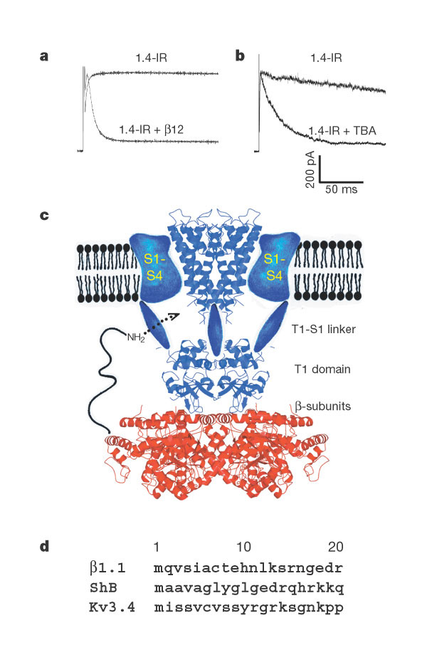
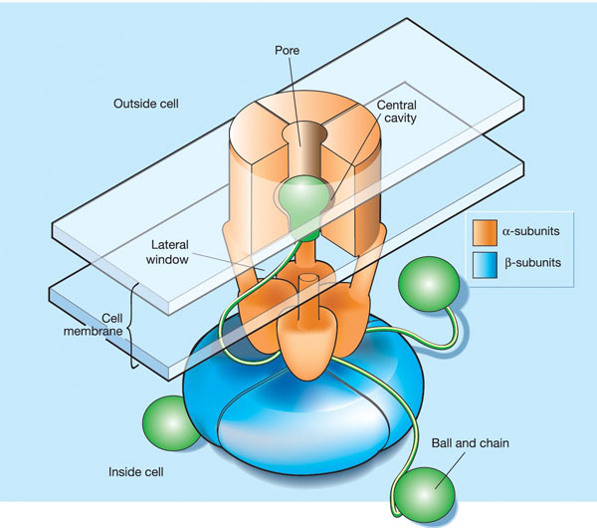
K+ Channel
Potassium channel receptor site for the inactivation gate and quaternary amine inhibitors.
Nature. 2001 Jun 7;411(6838):657-61.

Slide 7
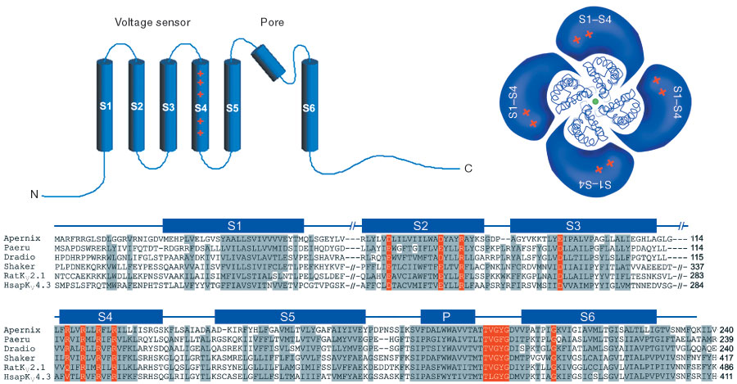
K+ Channel - II
Figure 1 Architecture of a voltage-dependent K +channel. Transmembrane-spanning segments (S1–S6) are labelled (blue segments); four subunits surround the pore. S1–S4 form the voltage sensor and S5–S6 form the pore, represented by the KcsA K +channel structure (backbone model). In sequences of prokaryotic and eukaryotic K Vchannels, regions of high homology are coloured in grey; functionally important residues are coloured red. Alignment was made with ClustalW followed by manual adjustment and exclusion of loops. The K +channels are: Apernix, Aeropyrum pernix (GI: 5104624); Paeru, Pseudomonas aeruginosa (GI: 15596693); Dradio, Deinococcus radiodurans (GI: 15805856); Shaker, Drosophila melanogaster (GI: 13432103); RatK V2.1, Rattus norvegicus (GI: 24418849); HsapK V4.3, Homo sapiens (GI: 5059060)
Nature 422 , 180 - 185 (2003)

Slide 8
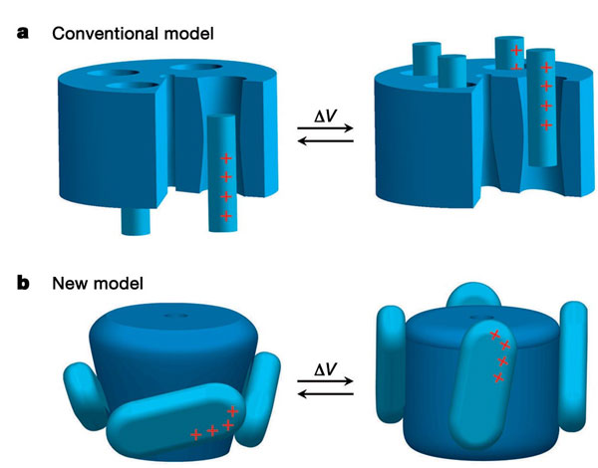
K+ Channel - III
Nature 423 , 33 - 41 (2003) X-ray structure of a voltage-dependent K +channel YOUXING JIANG*, ALICE LEE, JIAYUN CHEN, VANESSA RUTA, MARTINE CADENE, BRIAN T. CHAIT & RODERICK MACKINNON

Slide 9
Mechanism II
1. The unionized form of local anesthetics diffuses through the nerve cell membrane to a specific hydrophobic binding site on the Na⁺ ion channel. The ability to exist in an ionized form improves water solubility and there may be polar interactions between the drug and the binding site. All the injectable anesthetics exist as a equilibrium mixture of ionized and unionized forms.

Slide 10
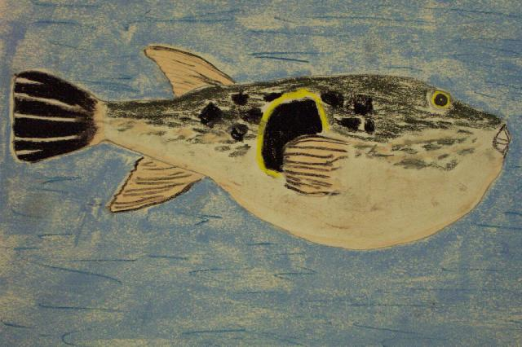
Tetrodotoxin
2. Other compounds, like toxins for instance, enter the ion channel from the exterior of the cell and bind to distinct, specific sites on the hydrophilic regions of the ion channel. Tetrodotoxin and Saxitoxin are examples. Tetrodotoxin is 10,000 fold more active in vitro than procaine with a lethal dose of 8 μg/kg. About 0.5 mg for humans.
Tetrodotoxin

Slide 11
More Mechanism Stuff
3. For the therapeutic compounds, Ca⁺² channel effects may also be involved. Premature displacement of Ca⁺² diminishes the response of an action potential. This shouldn’t be a surprise, but indicates that Ca⁺² channels may play a role and be a potential target site for local anesthetics.
4. Finally, we have the famous “membrane structure effect” Interactions with membrane lipids may play a role, but there are several arguments against this. More when we talk about general anesthetics.
Topical, non-injectable local anesthetics
Isogramine - lost in antiquity. Has systemic side effects and relatively short duration.
Phenol - topical. An active ingredient in sore throat medicine. Chloraseptic.
Benzyl alcohol - similar to phenol
Eugenol - found in oil of clove. Used for toothache.
Benzocaine - good topical anesthetic. Not water soluble enough to be used for injection. Sunburn cremes, skin cremes. Also in chloraseptic lozenges

Slide 12
Structures - I
1. Topical anesthetics

Slide 13
Stuctures - II
2. Compounds that bind on the outside of the Na⁺ ion channel with affinities of 2-8 nM. Tetrodotoxin from Fugu and Saxitoxin from dinoflagellates (red tides).

Slide 14
Structures - III
3. Injectable local anesthetics. These can exist in either ionized and unionized forms.
4. Miscellaneous Local Anesthetics.

Slide 15
Local Anesthetic Structure-Activity Relationships.
A. Benzoic Acid Derivatives:
These are synthetic compounds patterned after cocaine.
Aryl group - This group is either attached directly to the carbonyl or through a vinyl group. Substituents on the aryl group that are electron donating (alkoxy, amino, alkylamino) enhance activity if at the para or ortho positions. (alter liposolubility.
X group - The bridge, X, may be C, O, N, or S. When X = N, these amides are less prone to hydrolysis.
Aminoalkyl group - This is not necessary for activity, but is used to form water-soluble salts. 3° amines are best.

Slide 16
LA SAR Continued.
B. Amides (Lidocaine analogs):
These are the progeny of isogramine.
Aryl group - Attached to an sp² carbon via a nitrogen bridge. Substituents at the 2 and 6 positions enhance activity, and also increase stability to hydrolysis. The amides are already more stable than esters
X group - The “carbonyl” X, may be C, O, or N. “Can be”, but is almost always “O”.
Aminoalkyl group - This is not necessary for activity, but is used to form water-soluble salts. 3° amines are best. Basically the same story as for the esters.

Slide 17
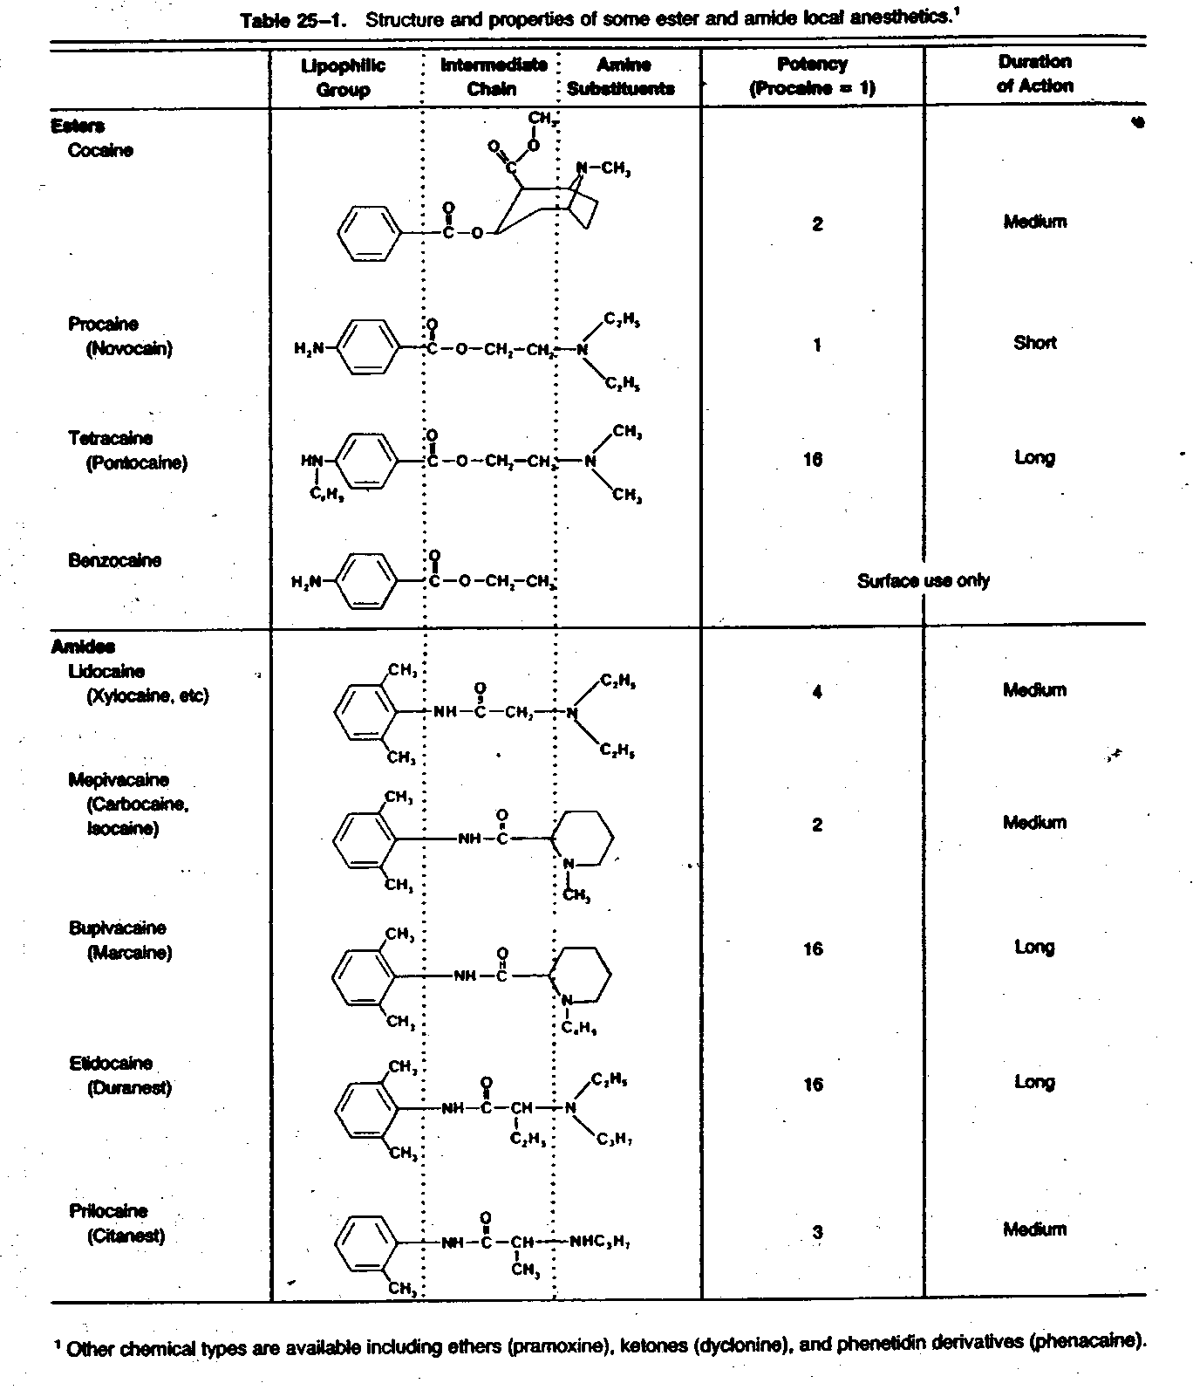
SAR III

